Slide 1
IRISH
MYTH
ology

Slide 2
Howaya!?!
Lets begin!!!

Slide 3
What is mythology
Irish mythology is the body of myths indigenous to the island of Ireland.
Orally passed down stories.
In the early medieval era.

Slide 4
What did the Irish do to the myths??,?
Sry if to bright :(((
Some myths were transcribed by Christian monks, who heavily altered and Christianised them.
Irish mythology is the best-preserved branch of Celtic mythology.

Slide 5
How many myths are there????
A lot…
There are uncountable amount of myths surrounding Ireland because of its very christian nature.
Here are the top 6 that we picked (next slide(s))
Folklores of the creatures and plants were bombing their way through ireland and through oral passage of them came very weird stories.

Slide 6
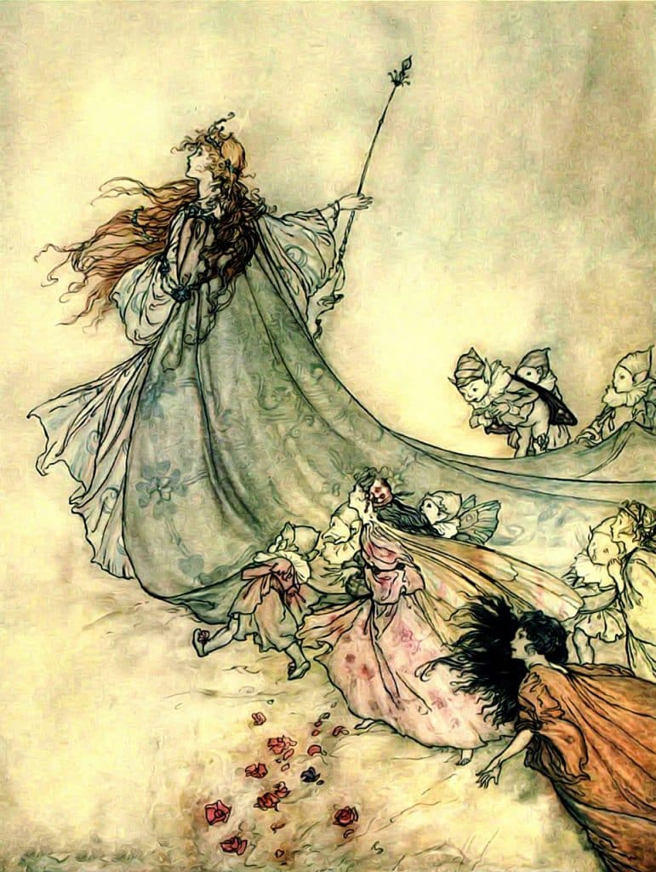
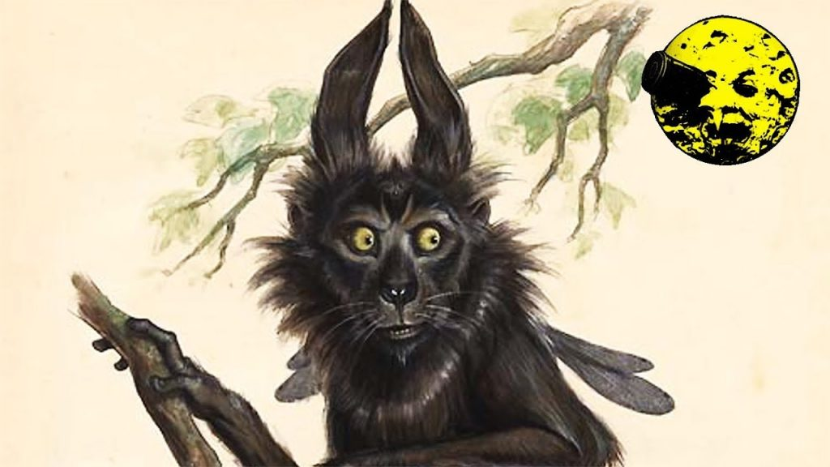
Top 6 most scariest irish myths!! (super scary)
Part 1
6. Fairies
5. The Pooka
One of the best Irish myths and legends has got to be the belief in fairies. Fairies were said to live in “cnocs agus sibhe” (mounds of earth).
The pooka (or púca) are shape-changers that are some of the most feared creatures in Irish mythology and folklore.

Slide 7
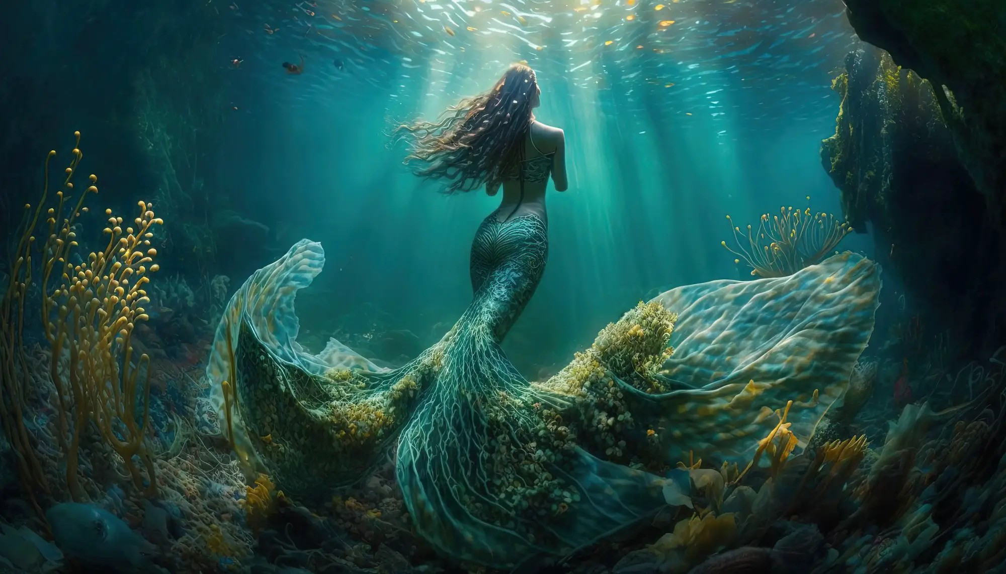
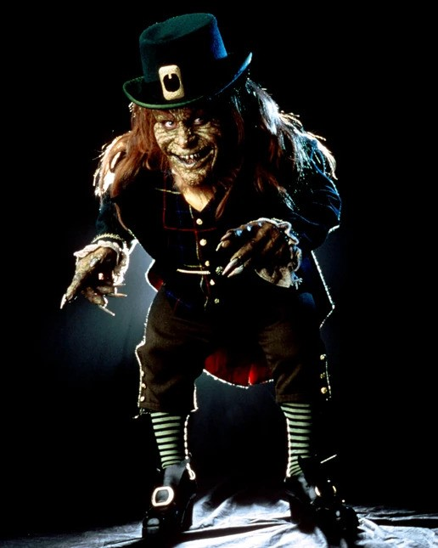
Top 6 most scariest irish myths!! (super scary)
Part 2
4.Mermaids
3.The leprechauns
The myth of mermaids in southern Europe tells of fair-faced, beautiful women. But irish think of them as pig-faced with sharp teeth.
the most famous little people (im him). Leprechauns or “Leath bhrògan” are the cultural symbol of Ireland, with their names translated from ‘shoemaker’. it is still said that you can find their pot of gold at the end of a rainbow.
Ez ide beúszott jsyk

Slide 8
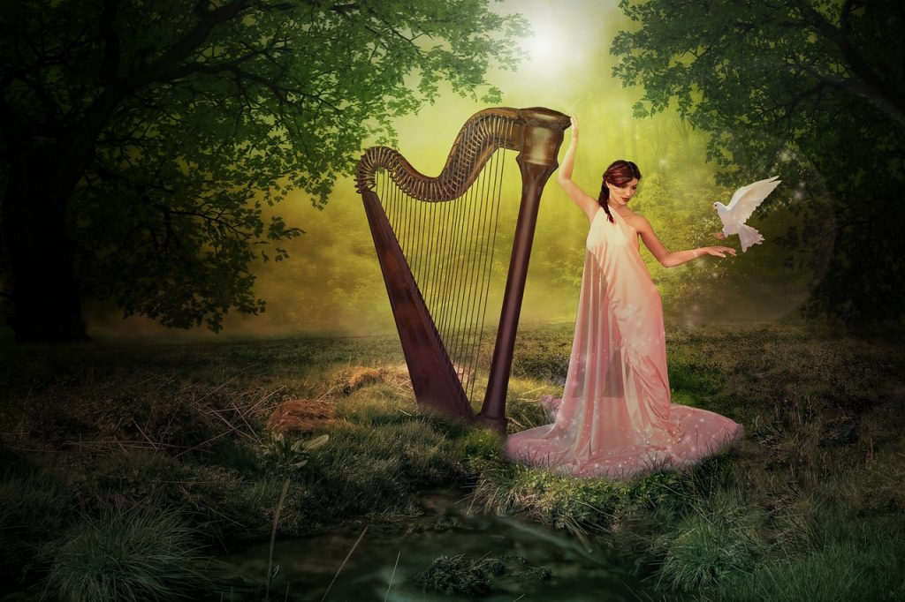
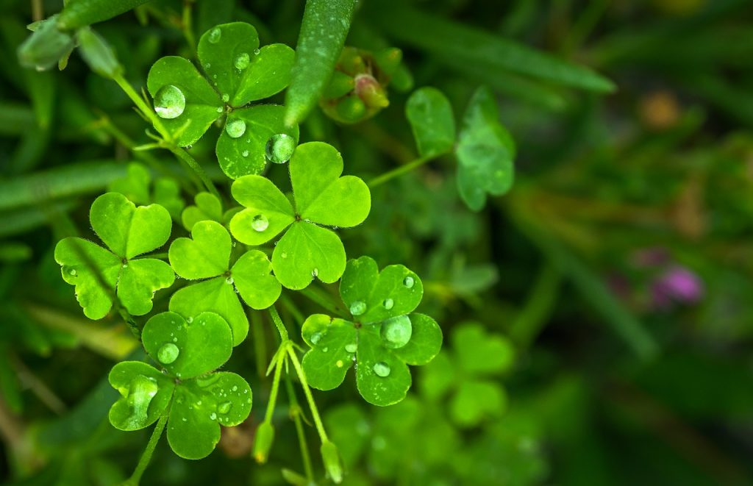
Top 6 most scariest irish myths!! (super scary)
Part 3
2.Harp
1.Shamrock
Evil gods stole the harp from Dagda. The instrument made up for the →happiness
in the country.
Very folk music tradition and icon of Ireland
Plant. Very important in the spreading of christianity. → St.Patrikc
Father←Son→Holy spirit

Slide 9
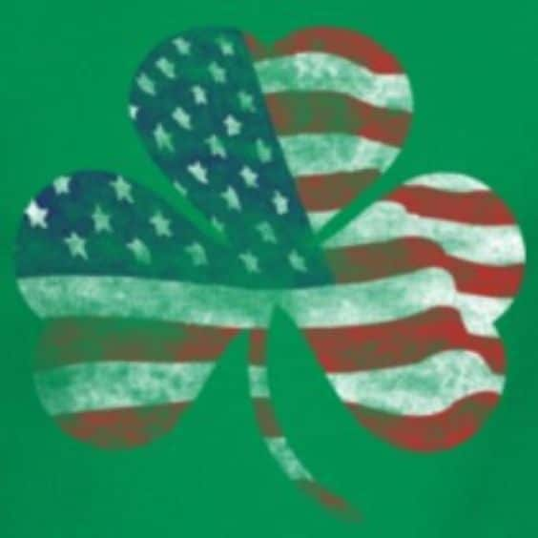
THANKS FOR WATC(HAC)HING!$
A very thank from the producers and directors and cast members and all th audio guys and gals and everyone and our brothers and sisters and to the holy spirit and father and son!

