Slide 1
The I.R.A (Irish Republican Army)

Slide 2
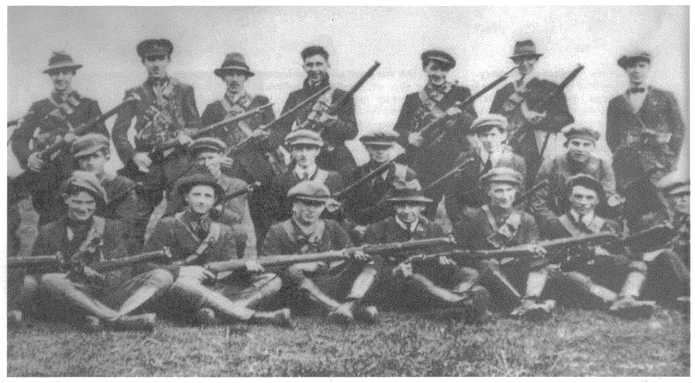
Origin of the army
It is an army that was first made by a group of Irish Volunteers and the Irish Citizen Army originated in 1917. In the following 100 years the I.R.A was reorganized, split up and changed multiple times.

Slide 3
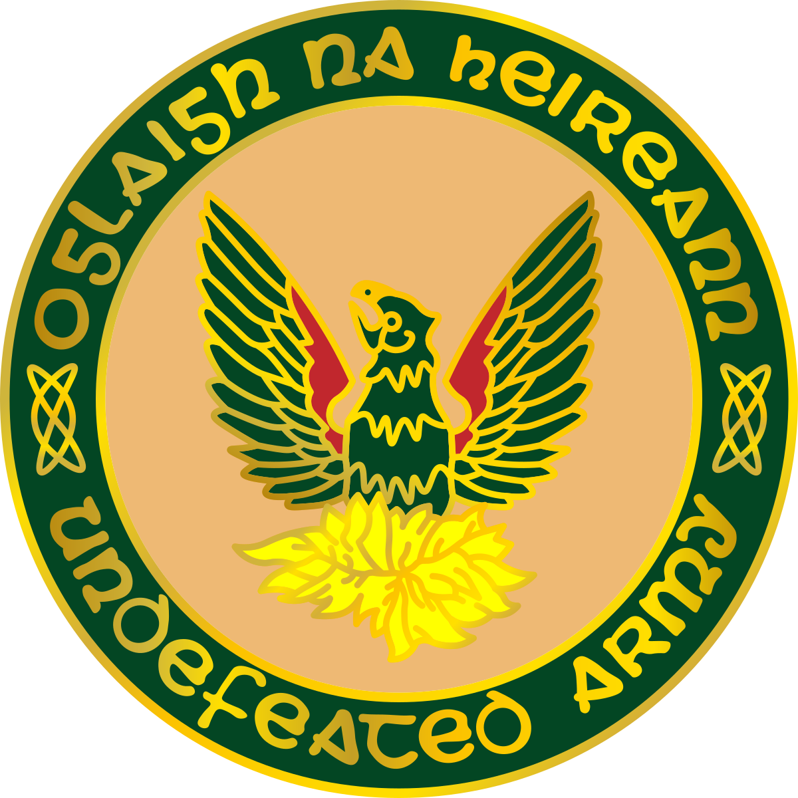
The big split of the I.R.A
Original I.R.A
More than 40 years after 1922, the form of the army kept changing until 1969, when it split into two parts the Original and the Provisional IRA.
Provisional I.R.A

Slide 4
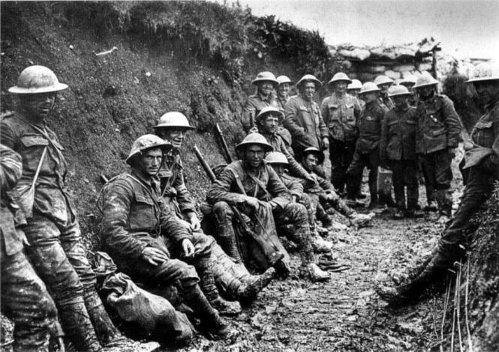
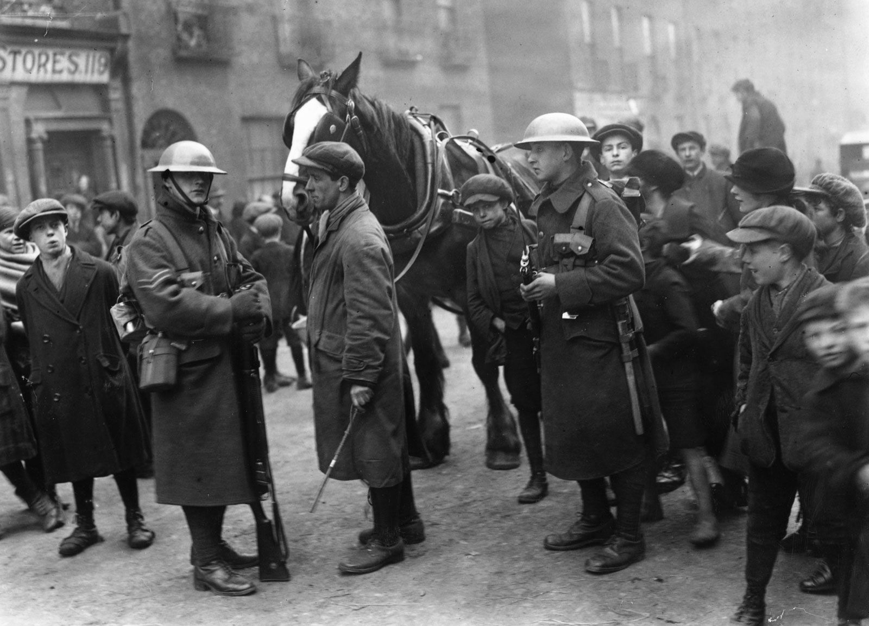
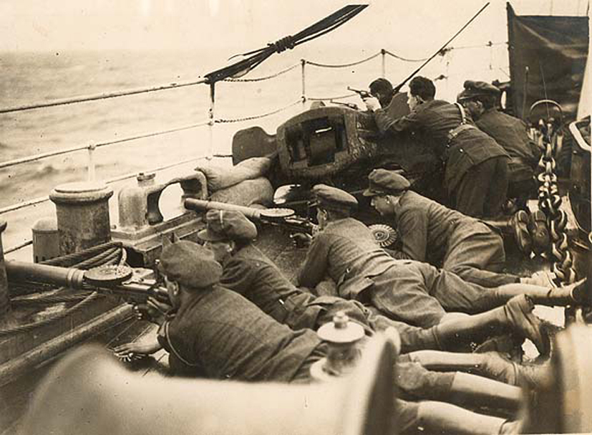
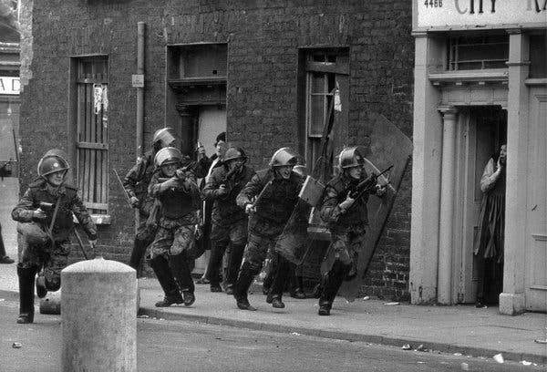
Which wars has I.R.A been part of
The I.R.A has participated in the following wars:
World War I. (1914-1918)
Irish War of Independence (1919-1921)
Irish Civil War (1922-1923)
The Troubles (1960-1998)

Slide 5
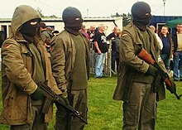
Terrorism of the I.R.A
The I.R.A has done illegal drilling and acts of violence many times. Although several countries didn’t support, wanted to stop this violent army, Ireland had the same goal as the army had: having the british off their land and getting back North-Ireland taken by Britain

Slide 6
Thanks for watching

