Slide 1
The politics of the British-Irish conflict

Slide 2
Irish elections and political parties
The Irish republic is a parliamentary democracy.
Elections every few years
Major political parties:
Fianna Fáil
Fine Gael
Labour Party
Sinn Féin

Slide 3
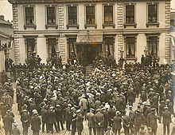
Irish War of Independence
Members of Sinn Féin were active in the Irish War of Independence
Before the war:
Irish republicans → Easter Rising → they proclaimed an Irish Republic
After the December 1918 election:
Sinn Féin won a landslide victory in Ireland
21 January 1919, Mansion House:
Sinn Féin formed a breakaway government
They declared Irish independence
September 1919
The British government outlawed the Dáil throughout Ireland
Sinn Féin was proclaimed in Country Cork
Mansion House

Slide 4
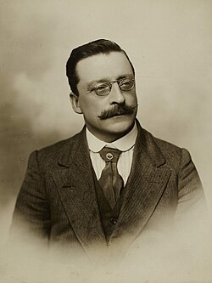
Sinn Féin
Irish republican and democratic socialist political party
Founded by Arthur Griffith in 1905
Phrase “Sinn Féin” → Irish for “Ourselves” / “We Ourselves”
Main political goal: a united Ireland
The party split before the Irish Civil War and again after it
For several decades, the remaining Sinn Féin organisation was small without any parliamentary representation
1970, at the start of the Troubles:
The party split again → modern Sinn Féin party, Worker’s Party
Arthur Griffith

Slide 5
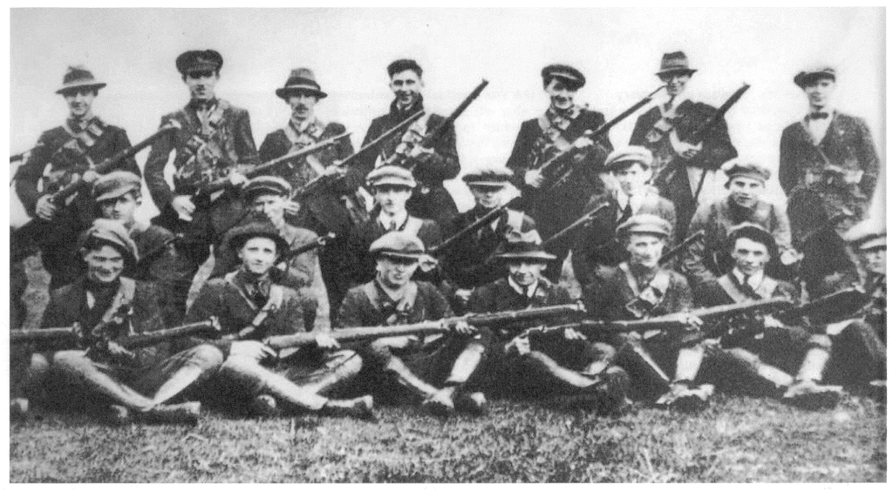
Irish independence
First attempt: 1782 (failed)
Easter Rising: April 1916 (during the first world war)
War of independence: 1919-1921
Creation of the original IRA: 1917
21. January 1919: Creation of breakaway government (Dáil Éireann)
Resolution: Anglo-Irish Treaty: 1921
Known in Ireland as "The Treaty"
Agreement between the government of the United Kingdom and the Irish Republic

Slide 6
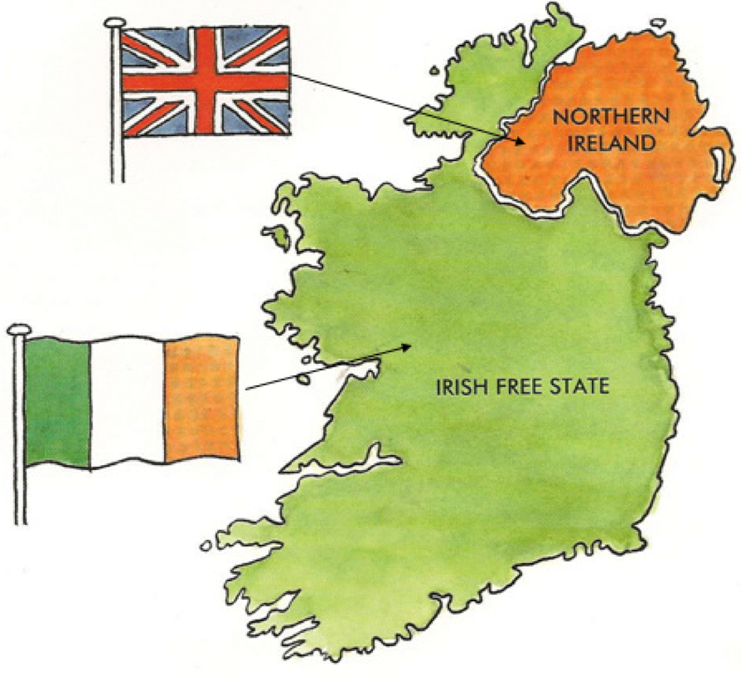
The aftermath
Irish Free State established in 1922
5/6 of the island became independent, 6 counties became Northern Ireland
Special powers act of Northern Ireland: 1922
Was effective until 1973
Gave the home affairs minister power to make any regulation felt necessary
Punishments: up to 1 year in prison, whipping
Almost exclusively used on the minority population

Slide 7
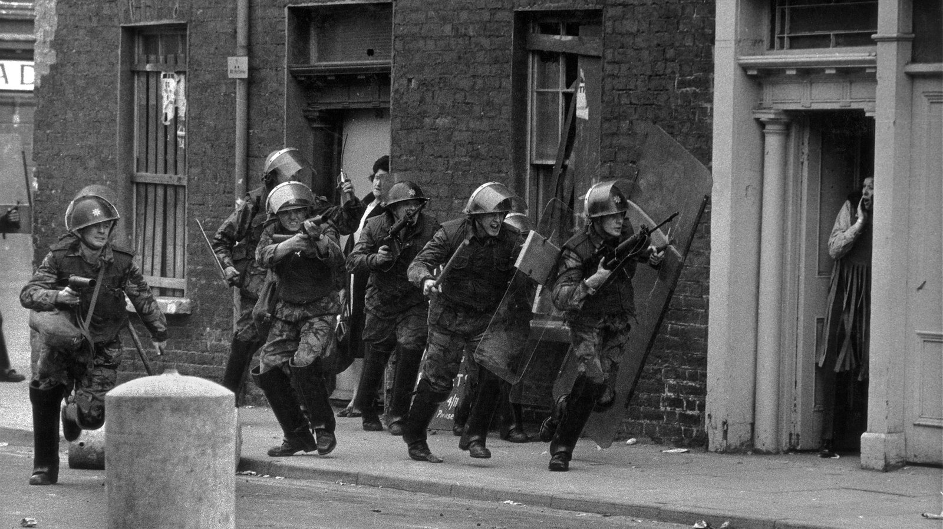
The Troubles
Mostly took place in Northern Ireland
Primarily political and nationalistic conflict
3500 people killed, 52% civilians
Two sides: catholic nationalistic minority <-> protestant ulster unionists
Beginning: 12-16. August 1969
Outbreak of political and sectarian violence
The Guildford pub bombings: 5. October 1974
IRA detonated 2 bombs at 2 pubs
The Guildford four (In the Name of the Father)
Operation Banner: 1969 – 2007
Good Friday Agreement: 1998

Slide 8
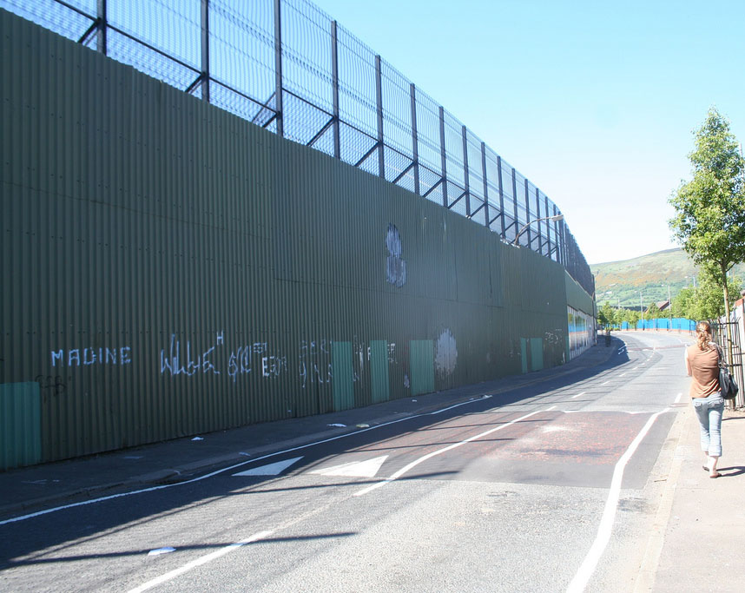
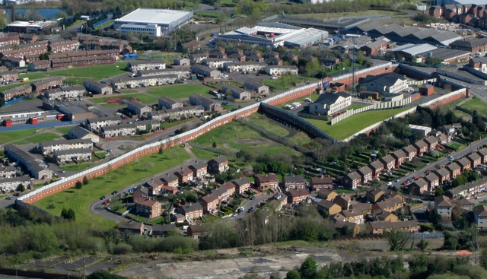
Peace lines

Slide 9
In the present day
Both countries were part of the European Union
Brexit: 2016 -> complicates the issue
Northern Ireland Protocol: 2019
Avoids a hard border between Ireland and Northern Ireland
Ensures the integrity of the European Single Market
Democratic Unionist Party protest: dissolution of Stormont: 3. February 2022
Sinn Féin
Supports reunification
DUP boycott over -> "in reaching distance"

